Slide 1
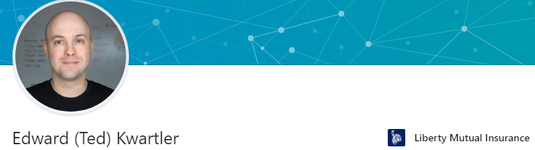








https://www.linkedin.com/in/edwardkwartler/
Side Hustles

Slide 2
Introductions…
Name
Location
Background
Why are you taking this course?
Are you working on VM, local or cloud?

Slide 3
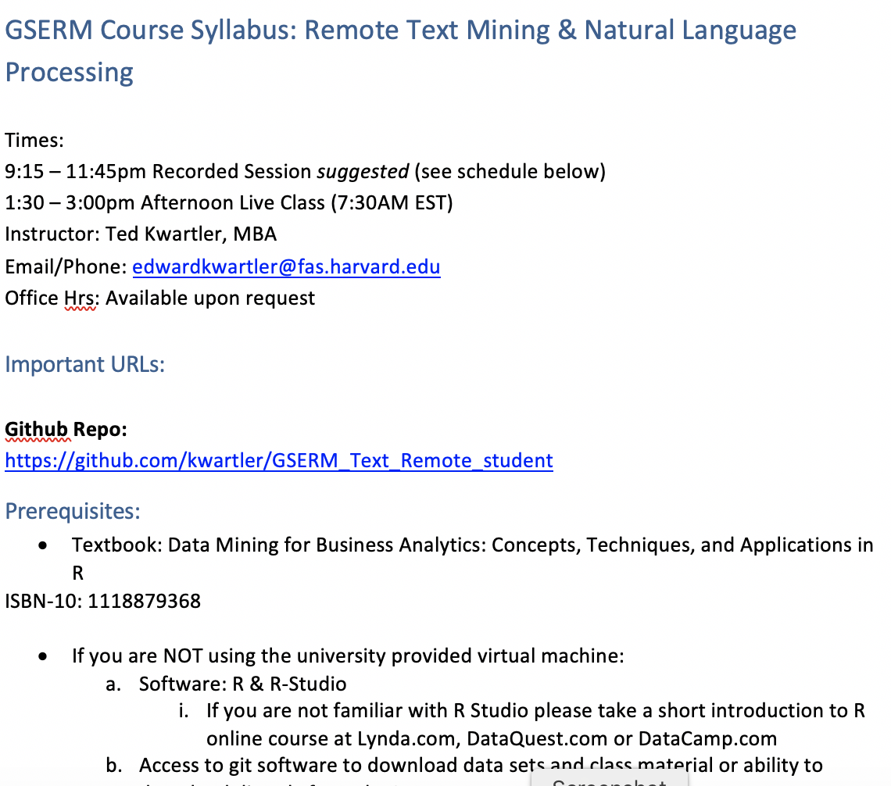
Syllabus Review

Slide 4
Community Learning Expectations
I expect:
Kindness > Cleverness
Active learning & participation
To make adjustments along the way so learning will be engaging & fun
Academic rigor
My goal for your learning experience is that the topics are:
Interesting
Applicable as a professional, researcher or future business person
Perspective building as a consumer affected by these methods
I do not expect:
Expert programmers or production quality coding skills – not really a programming course
Significant math skills – not a heavy math course

Slide 5
My style
You learn from being challenged
This is a intensive 1 week course requiring programing.
Don’t be intimidated if its your first time with R. My job is your learning outcomes. I am here to help.
It can be uncomfortable learning something new.
Discomfort means you are applying/challenging yourself. It’s ok and expected.
The professor doesn’t give everyone the top scores & no extra credit.
You earn the actual grade but I am fair and reasonable
“Homework/reading is taking hours & I want to go to social activities.”
You are earning credit in an intensive manner. Expect intensity and rigor at a prestigious institution.

Slide 6

Some motivation
If you are struggling, ask Prof help, evening labs, lunchtime office hours, email or even smoke signals, whatever it takes to succeed.
Focus on your learning outcomes
Don’t focus on your grade
You own the level of effort & engagement in your learning
I am focused on your learning outcomes
I don’t care if you need a specific grade to graduate
I take my role seriously mirroring your effort & engagement to support learning

Slide 7
Video 1 Q/A
Who had trouble installing R?
Who had trouble installing Rstudio?
Who had trouble installing Git?

Slide 8
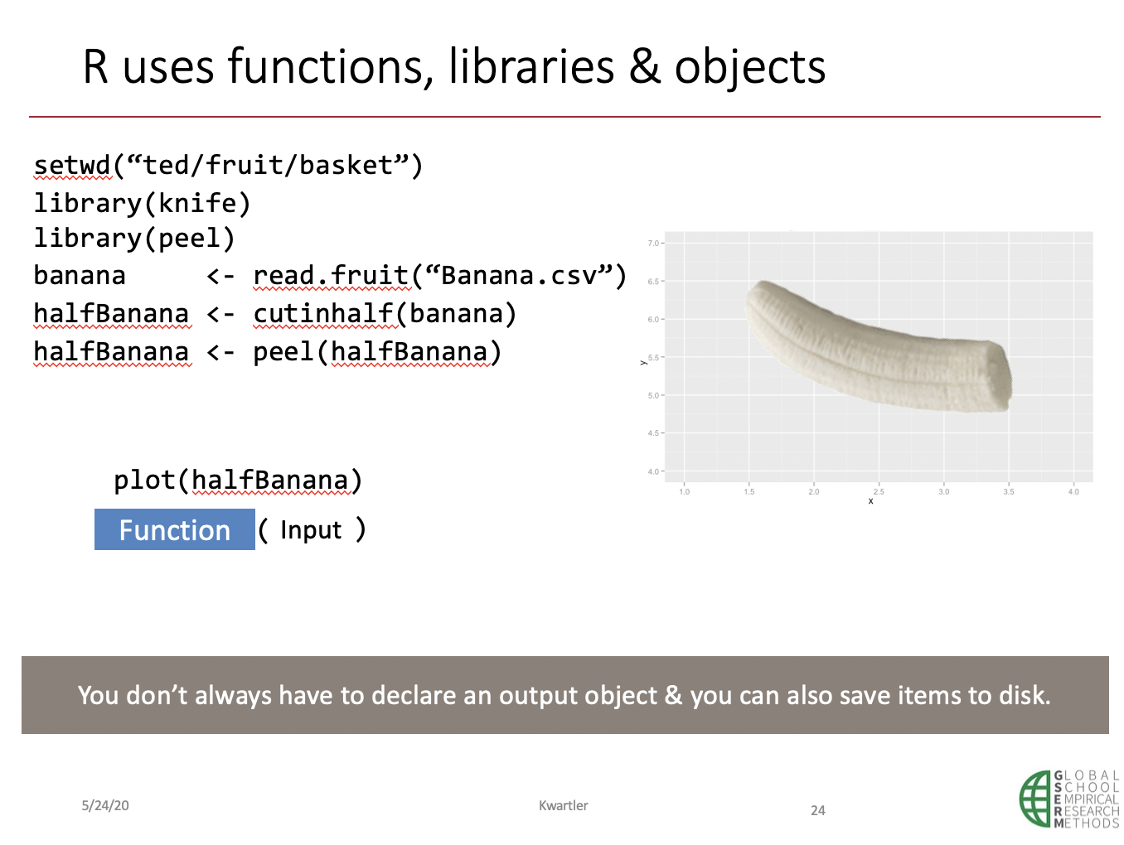
Video 2 Q/A
Does the input, function, output process make sense?
Does the banana analogy and workflow make sense?
What is “<-” called?
Why do we need libraries in R?

Slide 9
In video 3, we took R for a test drive.

Slide 10
Let’s do a bit more similar to vid3.
Please open LiveA_R_Basics.R

Slide 11
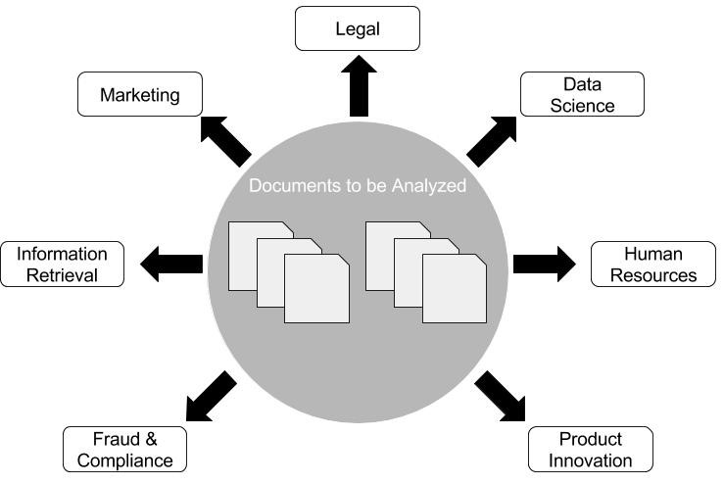
Video 4: What uses of TM do you observe, research or want to perform?

Slide 12
Video 4 Code Step through for live questions.
The foundation of most of this week’s course is a DTM.
﻿G_text_organization.R

Slide 13
Live Discussion Point
Why are these matrices sparse? What do they represent?
In a Document Term Matrix what is each row?
In a Term Document Matrix what is each row?
Code to Create the DTM/ and change to a matrix
txtDTM <- DocumentTermMatrix(txtCorpus)
txtTDM <- TermDocumentMatrix(txtCorpus)

Slide 14
Let’s do a bit more similar to vid4.
Please open LiveB_R_StringManipulation.R

Slide 15
Optional: Day 1 Homework Help
Please open LiveC_Day1_HW_mimic.R

